Slide 1


Cyclistic Case Study
Skylar XU
Data Analytics Project

Slide 2
Agenda
Ask
Prepare
Process
Analyze
Share
Act

Slide 3
Background
Ask
Cyclistic is a fictional company of bike sharing in Chicago. Their strategy is based on the flexibility of pricing plans they offer as well as the diversity of bikes, customers can choose the membership and bike that suit them.

Slide 4
Primary Finding: Cyclistic’s financial analysts have concluded that annual members are much more profitable than casual riders.
Primary task: to figure out the difference of bike usage between casual riders and members.
Primary goal: analyze dataset to develop strategies about how to transfer casual riders to annual members.
ASK

Slide 5
Prepare
The datasets are given as monthly-based trip data in a .zip file. I downloaded the trips from November 2021 to October 2022 in .zip files and extracted them into a folder that I named Datacase 1. Each file was a .csv file, so we were ready for the next phase which is process.

Slide 6
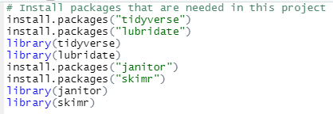
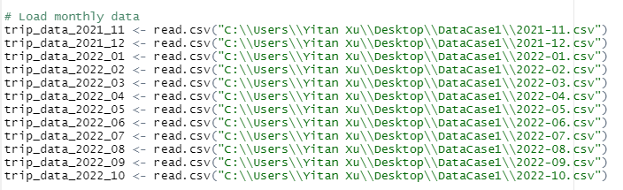
Process

Slide 7
Process
Use R programming for processing my data because it was too big to be processed in a spreadsheet or excel. The original dataset dimension when combined was 5954401 x 13.
# Check column names to ensure we can join all the data
colnames(trip_data_2021_11)
colnames(trip_data_2021_12)
…
compare_df_cols(trip_data_2021_11, trip_data_2021_12,
trip_data_2022_01, trip_data_2022_02,
trip_data_2022_03, trip_data_2022_04,
trip_data_2022_05, trip_data_2022_06,
trip_data_2022_07, trip_data_2022_08… ,
return = "mismatch")

Slide 8

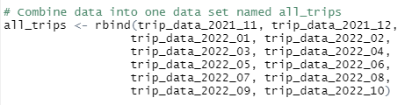
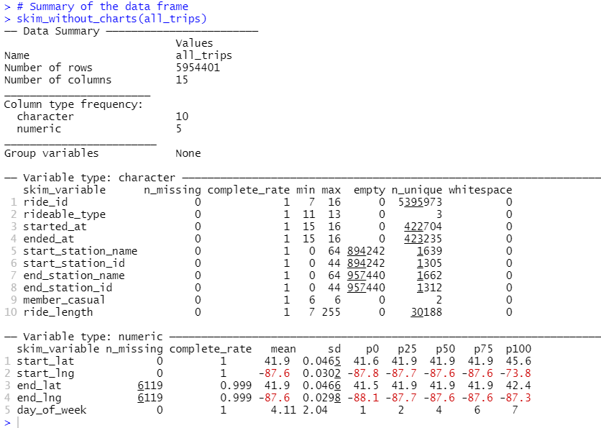
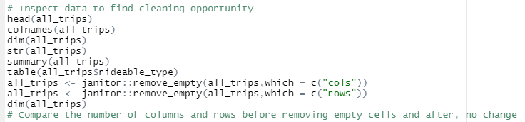
Process

Slide 9
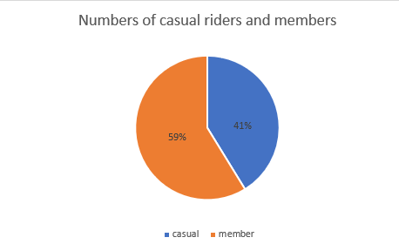
Analyze
The number of members are slightly larger(59%) than casual riders(41%) and higher than a half of all bike riders.
The percentage of membership is quite decent, however, there is market to transfer more casual riders to members.

Slide 10
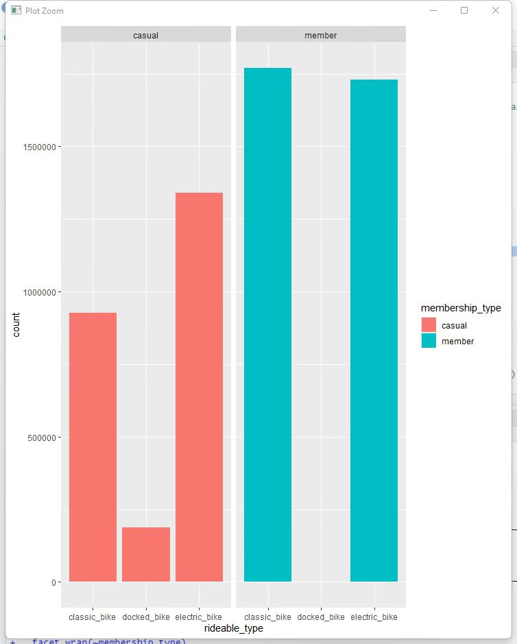
Analyze
Usage of rideable types
The usages of classic bikes and electric bikes by members are obviously higher.
Docked bikes are solely used by casual members.

Slide 11
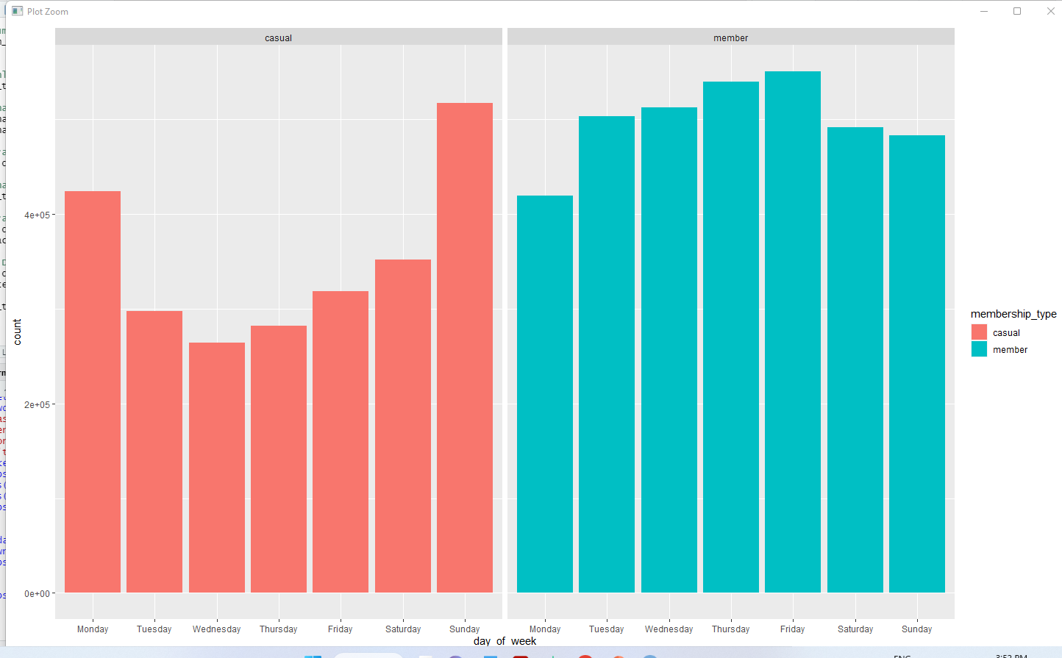

Analyze
For casual riders, the number of rides on Monday and Sunday are higher. The rides on Sunday is even larger than ones on some days for members.
For members, the difference among rides during days of weeks is not very significant except for Monday (the lowest).

Slide 12
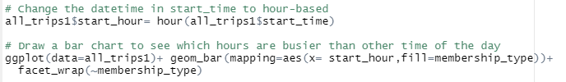
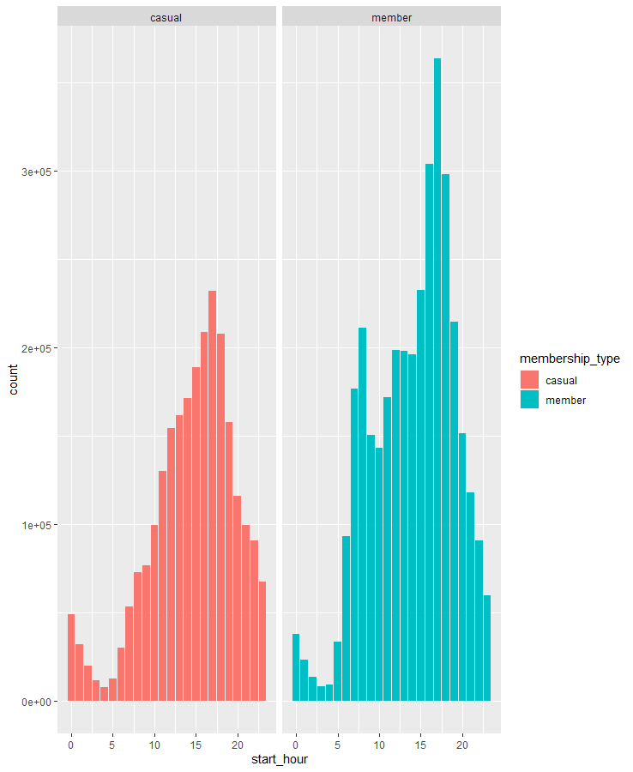
Analyze
For the chart of casual riders, from early morning(5 am) to the middle of the night(12 am), the shape of the number of rides is approximately a bell curve.
For the chart of members, a peak appears during rush hour (8 am) and reaches another highest point at 5 pm.
Assumption: the main purpose of casual riders is probably entertainment, like sightseeing and exercising. Most members use bikes to commute from work.

Slide 13
Share
The R code and slides of this presentation are shared on my website.

Slide 14
Act
Dataset is big enough to make some assumptions but it is risky to jump to any conclusion.
From the chart of rideable types, only a few people use docked bikes.
1) Cancel docked bikes to lower costs
2) Dig into the reason why people do not
use it and open a market.
Figure out the reason why casual riders use bikes on Monday and if the decrease in usage by members is caused by a lack of bikes.
Collect more data by handing out surveys to casual riders about their purpose of rides, financial situation, and so on.
Design more types of memberships, for example, certain weekdays or hours to increase occupation.
Marketing about the benefits of cycling, like being environmentally friendly, and burning calories.

Slide 15
Thank you
Skylar Xu
xuyifanca@gmail.com

